Slide 1
MACHINE LEARNING PROJECT
Credit Card Fraud Detection
Predictive Modeling on Highly Imbalanced Transaction Data
284,807
transactions analyzed
97.7% AUC
best model (XGBoost)
4 models
compared & evaluated
Ayush Tiwari
Python · Scikit-learn · XGBoost · LightGBM · CatBoost

Slide 2
THE PROBLEM
Why Fraud Detection Is Hard
Credit card fraud costs banks and customers billions every year. The core challenge isn't building a model — it's building one that works when fraud is extremely rare and disguised among millions of legitimate transactions.
DATASET SNAPSHOT
284,807
Extreme class imbalance
Total transactions
Only 0.17% of transactions are fraudulent — accuracy alone is a misleading metric.
492
Anonymized features
Fraudulent cases (0.17%)
28 PCA-transformed features (V1–V28) hide raw details, so patterns must be learned, not assumed.
31
Cost of false negatives
Features (incl. Time & Amount)
Missed fraud directly costs money; missed legitimate flags hurt customer experience.
48 hrs
Span of transaction data

Slide 3
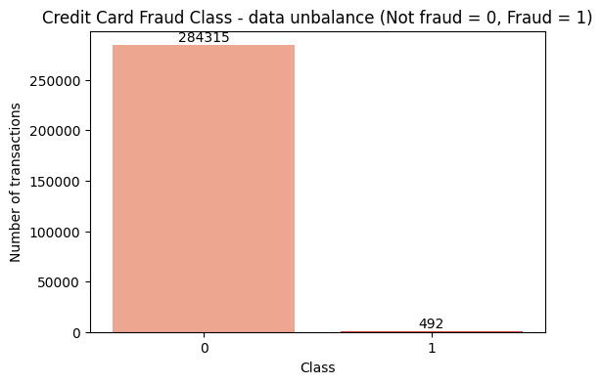
DATA EXPLORATION
A Severely Imbalanced Dataset
Verified data integrity
No missing values across 284,807 rows and 31 columns — confirmed before any modeling began.
Identified the imbalance problem
Just 492 of 284,807 transactions are fraud — a 1:578 ratio that rules out plain accuracy as a metric.
Studied time-based behavior
Fraudulent transactions are spread more evenly across time, including unusual off-peak hours.
Class distribution: Not Fraud (0) vs Fraud (1)
Credit Card Fraud Detection • ML Project
3

Slide 4
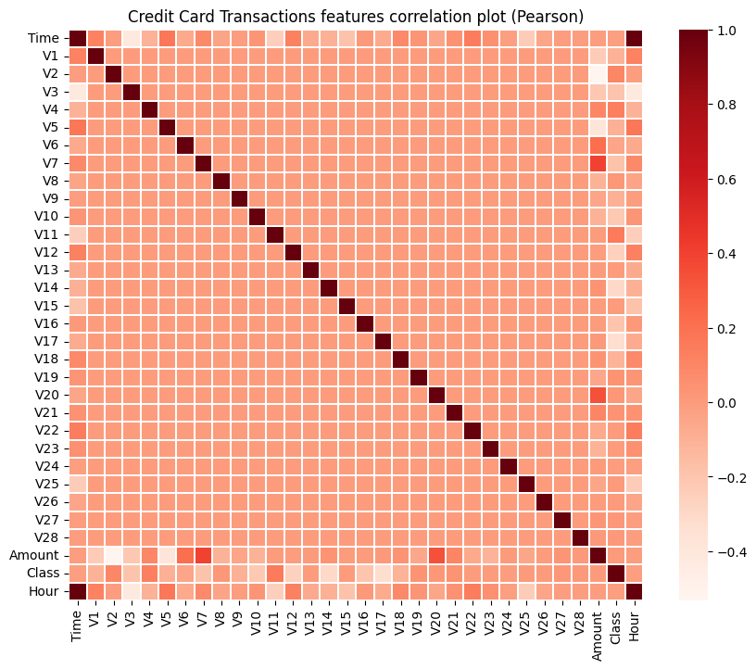
DATA EXPLORATION
Feature Correlation & Patterns
Engineered Time into Hour buckets
Converted raw seconds into hourly windows to reveal transaction-volume and amount trends across the day.
Found PCA features mostly independent
V1–V28 show little correlation with each other, confirming they are pre-processed, decorrelated PCA components.
Spotted Amount-linked features
V7 and V20 trend positively with Amount; V1, V2 and V5 trend inversely — useful signal for modeling.
Pearson correlation across all 31 features
Credit Card Fraud Detection • ML Project
4

Slide 5
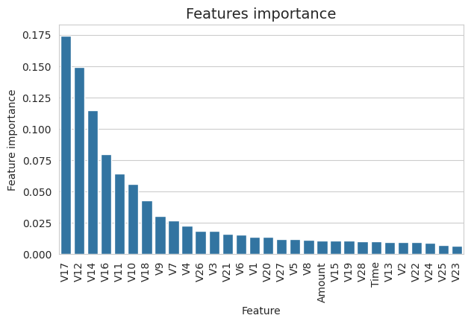
FEATURE ENGINEERING
What Predicts Fraud Best
Top predictive signals
V17
V12
V14
V10
V11
V16
Used across all four models
V17, V12 and V14 consistently ranked as the strongest predictors of fraud across Random Forest, CatBoost, XGBoost and LightGBM.
Guided feature selection
Density plots showed V4, V11, V12, V14 and V18 have clearly separated distributions between fraud and non-fraud classes.
All 30 predictors retained
Time, Amount and V1–V28 were all fed into the models; tree-based methods naturally down-weight the weak ones.
Random Forest feature importance ranking
Credit Card Fraud Detection • ML Project
5

Slide 6
METHODOLOGY
Four Models, One Goal
Data was split into train, validation and test sets. Each model was trained on the same predictors and evaluated using ROC-AUC — the right metric for a highly imbalanced classification problem.
Random Forest
CatBoost
LightGBM
BEST MODEL
BAGGED DECISION TREES
GRADIENT BOOSTING
GRADIENT BOOSTING
XGBoost
Baseline ensemble model; trained with Gini criterion, 100 estimators.
Handles feature interactions well; trained for 500 boosting iterations.
Leaf-wise growth for speed; tuned with early stopping on AUC.
GRADIENT BOOSTING
Best overall performer; validated with early stopping across 240+ rounds.
Credit Card Fraud Detection • ML Project
6

Slide 7
RESULTS
Model Performance Comparison
KEY RESULT
97.7%
AUC achieved with XGBoost — a 12-point lift over the Random Forest baseline.
Why XGBoost won
Early stopping + validation-based tuning let it generalize best to unseen test transactions.
ROC-AUC on the held-out test set (higher is better)
Credit Card Fraud Detection • ML Project
7

Slide 8
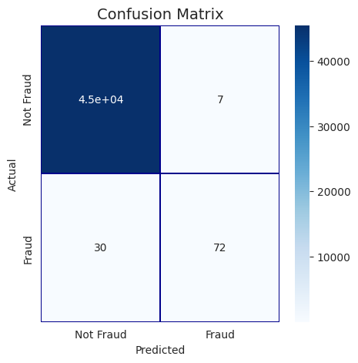

RESULTS
Evaluating Real Fraud Catch-Rate
Why ROC-AUC over accuracy
With fraud at just 0.17% of records, a model predicting “not fraud” every time would score 99.8% accuracy — but catch zero fraud. AUC measures true separation between classes.
Confusion matrices validated the trade-off
Each model's predictions were cross-checked against actual labels to balance catching fraud against false alarms on genuine customers.
Business takeaway
A high-AUC model like XGBoost can flag suspicious transactions for review while keeping false alarms on real customers low.
Random Forest
CatBoost
Credit Card Fraud Detection • ML Project
8

Slide 9
CONCLUSION
From Raw Transactions to a
Production-Ready Fraud Signal
97.7%
Best ROC-AUC (XGBoost)
Explored 284K+ transactions end-to-end — handled extreme class imbalance, engineered time-based features, and benchmarked four machine learning models. XGBoost delivered the strongest result at 97.7% ROC-AUC, making it the most reliable choice for flagging fraudulent transactions in production.
284,807
Transactions processed
4
TECH STACK
ML models benchmarked
Python
Pandas
NumPy
6
Scikit-learn
XGBoost
Top predictive features
LightGBM
CatBoost
Matplotlib
Seaborn
Ayush Tiwari | ayusharies1o@gmail.com

